Slide 1
Techtonix Dashboard
Ayodeji esan

Slide 2
Executive Summary
This report presents an in-depth analysis of Techtronix Innovations' sales performance, customer insights, inventory management, profitability, and market expansion opportunities. Utilizing the Power BI dashboard, i have identified key trends, operational inefficiencies, and potential growth areas, providing actionable recommendations to address the company's current challenges.

Slide 3
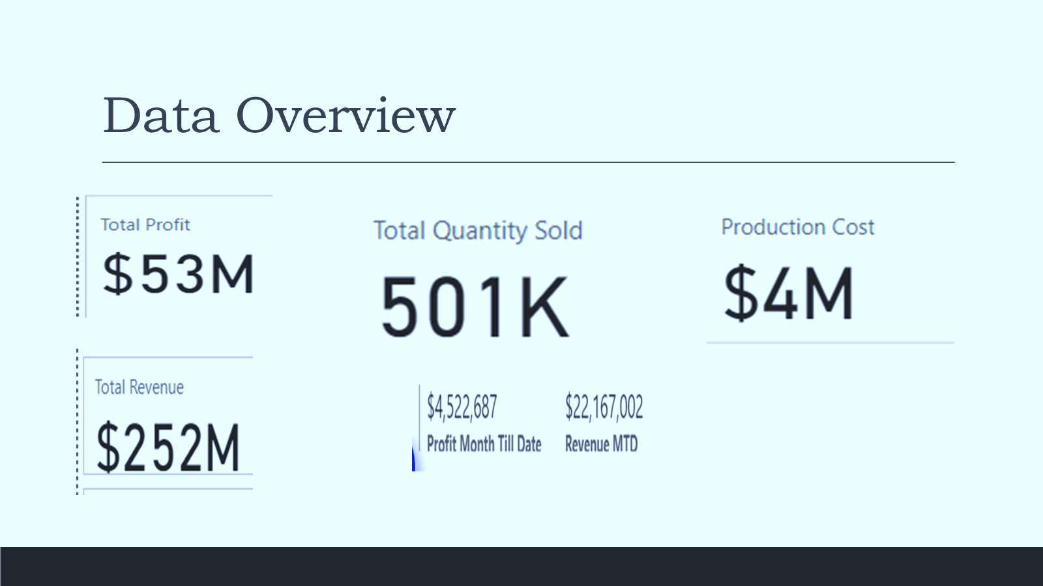
Data Overview

Slide 4
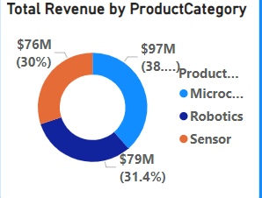
. Sales Performance Analysis
The Microchip category has consistently driven the highest sales revenue, particularly in the automotive sector. The sensors category shows fluctuating sales, indicating market volatility.

Slide 5
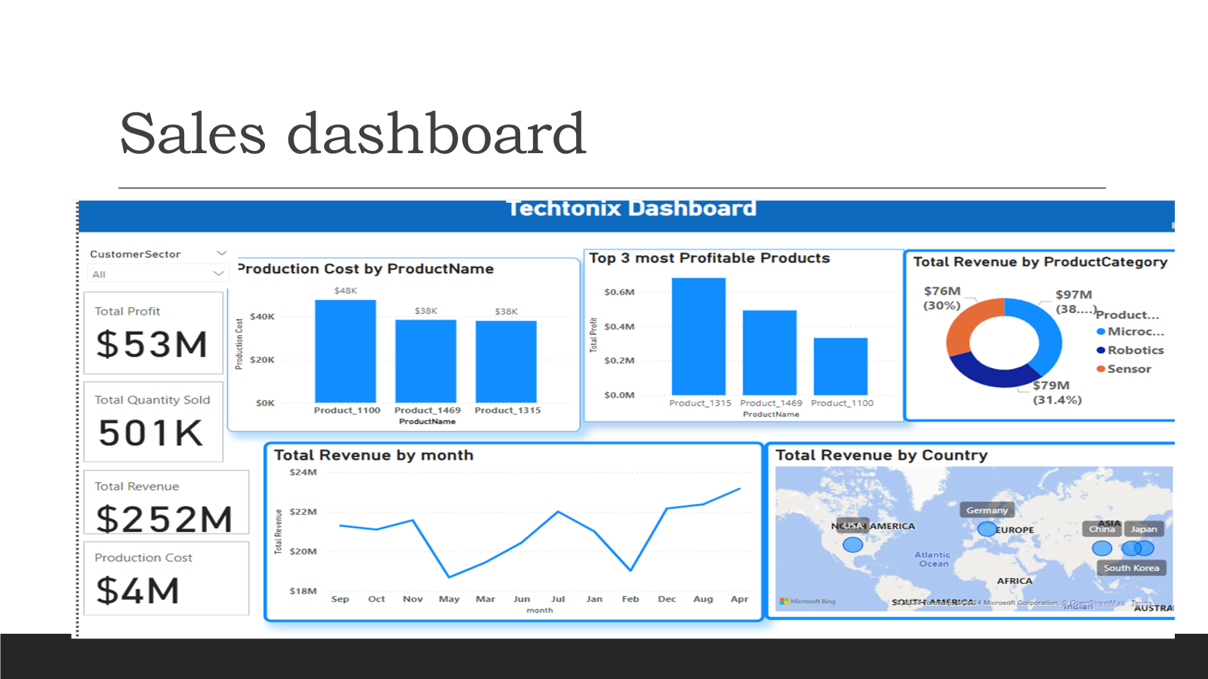

Slide 6
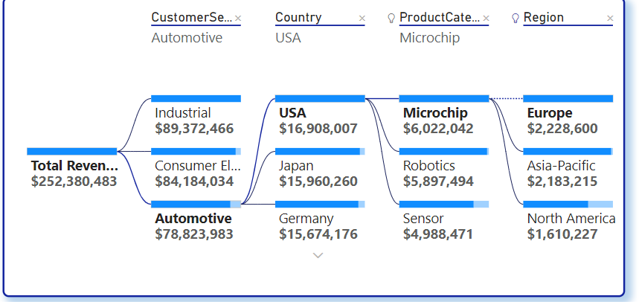
Customer Insights
The majority of sales come from Asia Pacific and EUROPE with a significant concentration of high-value customers in the consumer and industrial sectors.

Slide 7
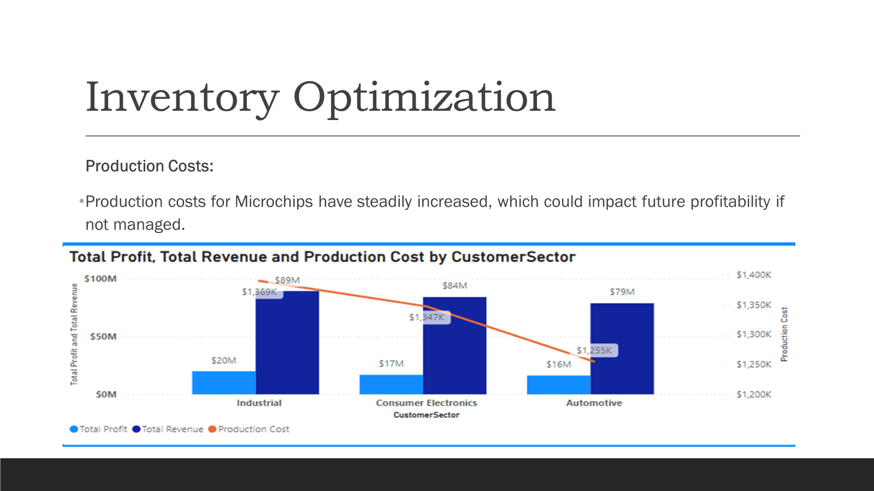

Slide 8
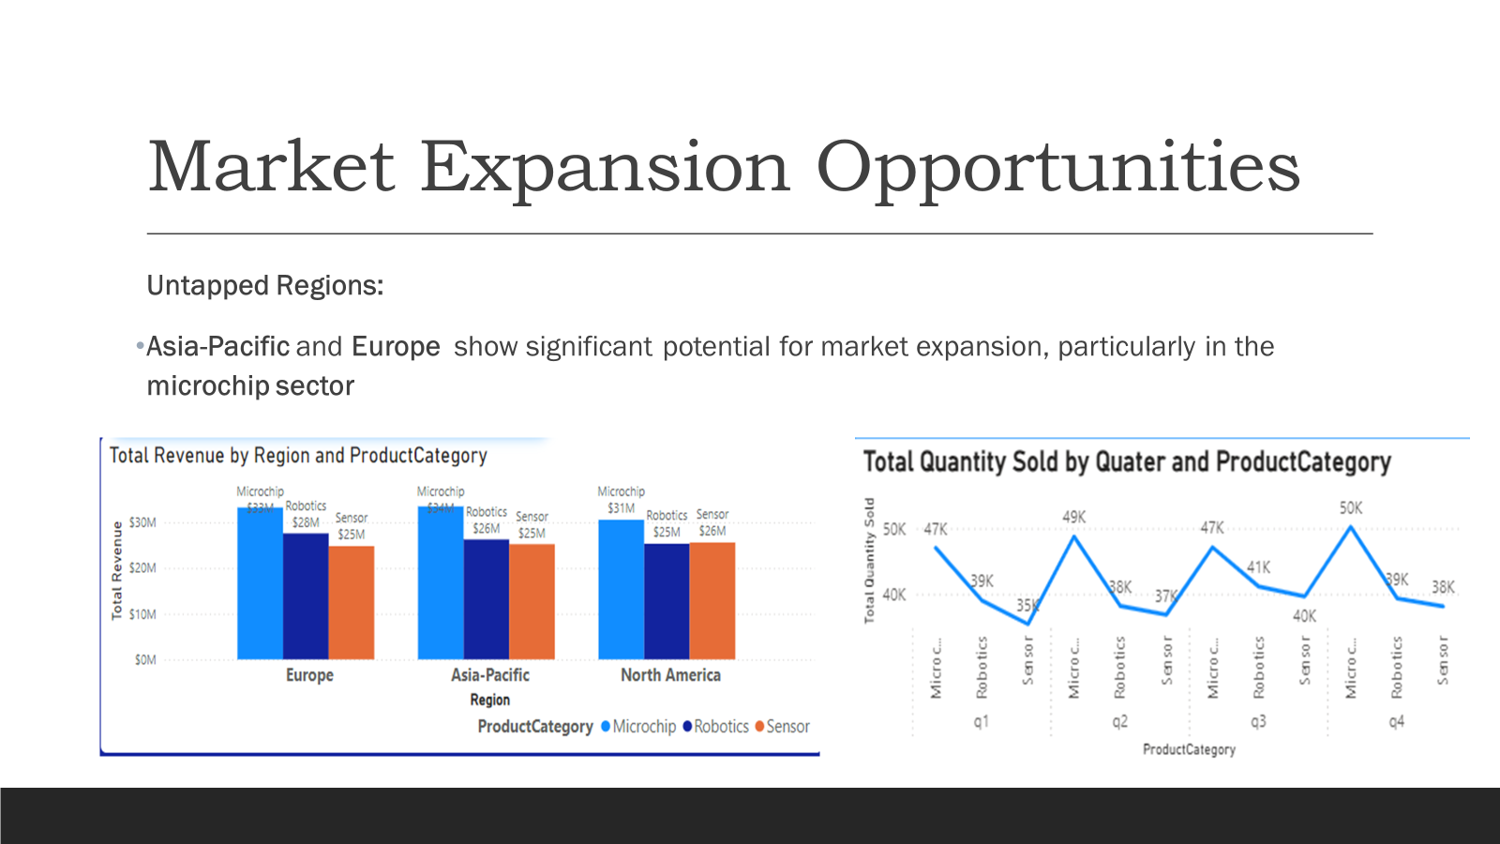

Slide 9
